Slide 1
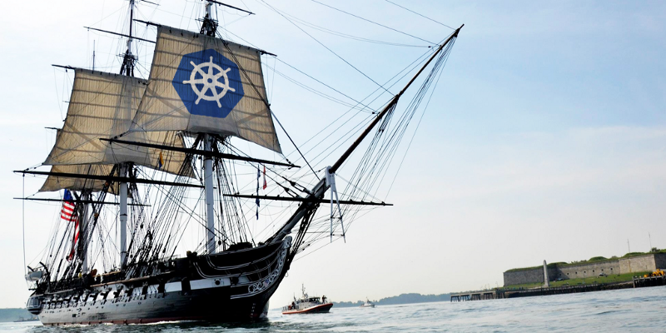
Using Kubernetes
Day 3
Nesia Amit

Slide 2
Agenda
Kubernetes Introduction
Kubernetes Introduction
Liveness and Rediness Probes
ConfigMap and Secrets
Volumes

Slide 3
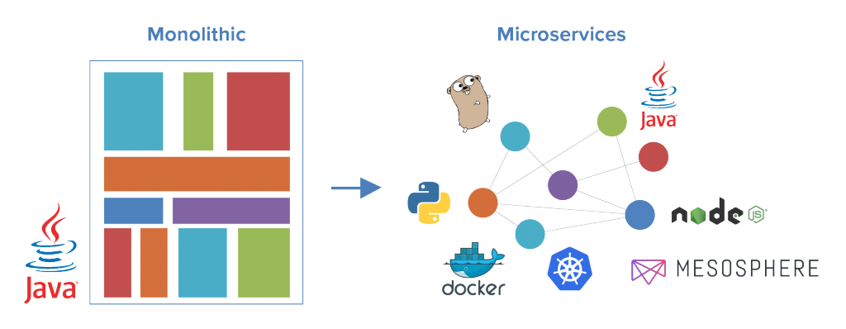
Monolith to Microservices Architecture

Slide 4
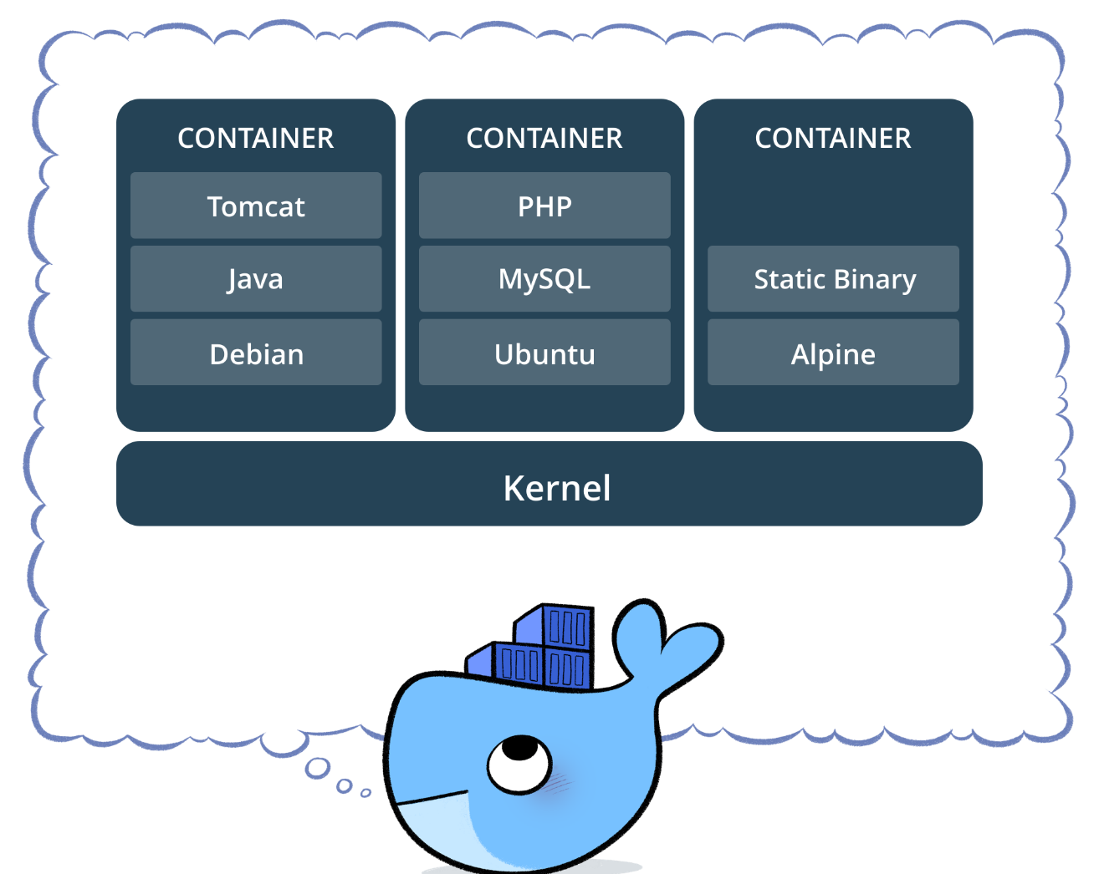
Containers (Docker or Rocket)
A container consists of an entire runtime environment: an application, plus all its dependencies, libraries and other binaries, and configuration files needed to run it, bundled into one package.

Slide 5
Technology to the rescue - Container Orchestration
The growing of microservices and the need to scale them introduced challenges like:
Auto Deploy our microservices quickly and predictably.
Scale our microservices on the fly.
Roll out new features seamlessly.
Limit hardware usage to required resources only.
This is where container orchestration platforms become extremely useful and powerful, because it offer a solution for those challenges

Slide 6
Kubernetes
Kubernetes is an open-source platform designed to automate deploying, scaling, and operating application containers.

Slide 7


Slide 8

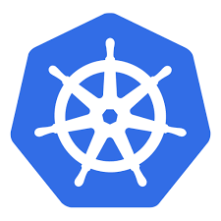
Kubernetes Cluster

Slide 9
Node
kublet
Docker

Slide 11


Slide 12
POD
Represents a unit of deployment: a single instance of an application in Kubernetes, which might consist of either a single container or a small number of containers that are tightly coupled and that share resources.
10.97.14.200
my-pod.yaml
apiVersion: v1
kind: Pod
metadata:
name: myapp-pod
labels: app: myapp
spec:
containers:
- name: myapp-container
image: busybox
command: ['sh', '-c', 'echo Hello Kubernetes! && sleep 3600']
# Create a pod from a file.
$ kubectl create –f my-pod.yaml

Slide 13
Deployment
my-deploy.yaml
apiVersion: apps/v1beta2
kind: Deployment
metadata:
name: nginx-deployment
labels:
app: nginx
spec:
replicas: 3
selector:
matchLabels:
app: nginx
template:
metadata:
labels:
app: nginx
spec:
containers:
- name: nginx
image: nginx:1.7.9
ports:
- containerPort: 80
A Deployment controller provides declarative updates for Pods and ReplicaSets
Using kubectl declarative command:
# Create a deployment from a file.
$ kubectl create –f my-deploy.yaml

Slide 14

kubectl create -f my-deploy.yaml
D
Master
Node#3
Docker
kublet
Node#1
kublet
Docker
Node#2
Kubernetes Cluster
kublet
Docker

Slide 15
Master Node
kube-apiserver
kube-ETCD
kube-Scheduler
kube-Controller-Manager

Slide 16
Service
A Service in Kubernetes is a REST object, meaning its definition can be POSTed to the apiserver to create a new instance.
This specification will create a new Service object named “my-service” which targets TCP port 80 on any Pod with the "app=MyApp" label.
my-service.yaml
kind: Service
apiVersion: v1
metadata:
name: my-service
spec:
selector:
app: MyApp
ports:
- protocol: TCP
port: 8080
targetPort: 80
# Create a service from a file.
$ kubectl create –f my-service.yaml

Slide 17
kube-apiserver notifies kube-proxy on every Node on new Service and Endpoints Objects:
kube-apiserver
kubelet
Dock
kubelet
Dock
10.10.10.2:80
my-app
kube-proxy
Iptables for service (with virtual ip) and endpoints
-A KUBE-SEP-57K ...
-A KUBE-SEP-5RZ ….
-A KUBE-SERVICES ….
-A KUBE-SVC-NW ...
-A KUBE-SVC-NV5 ….
kubelet
Docker

Slide 18
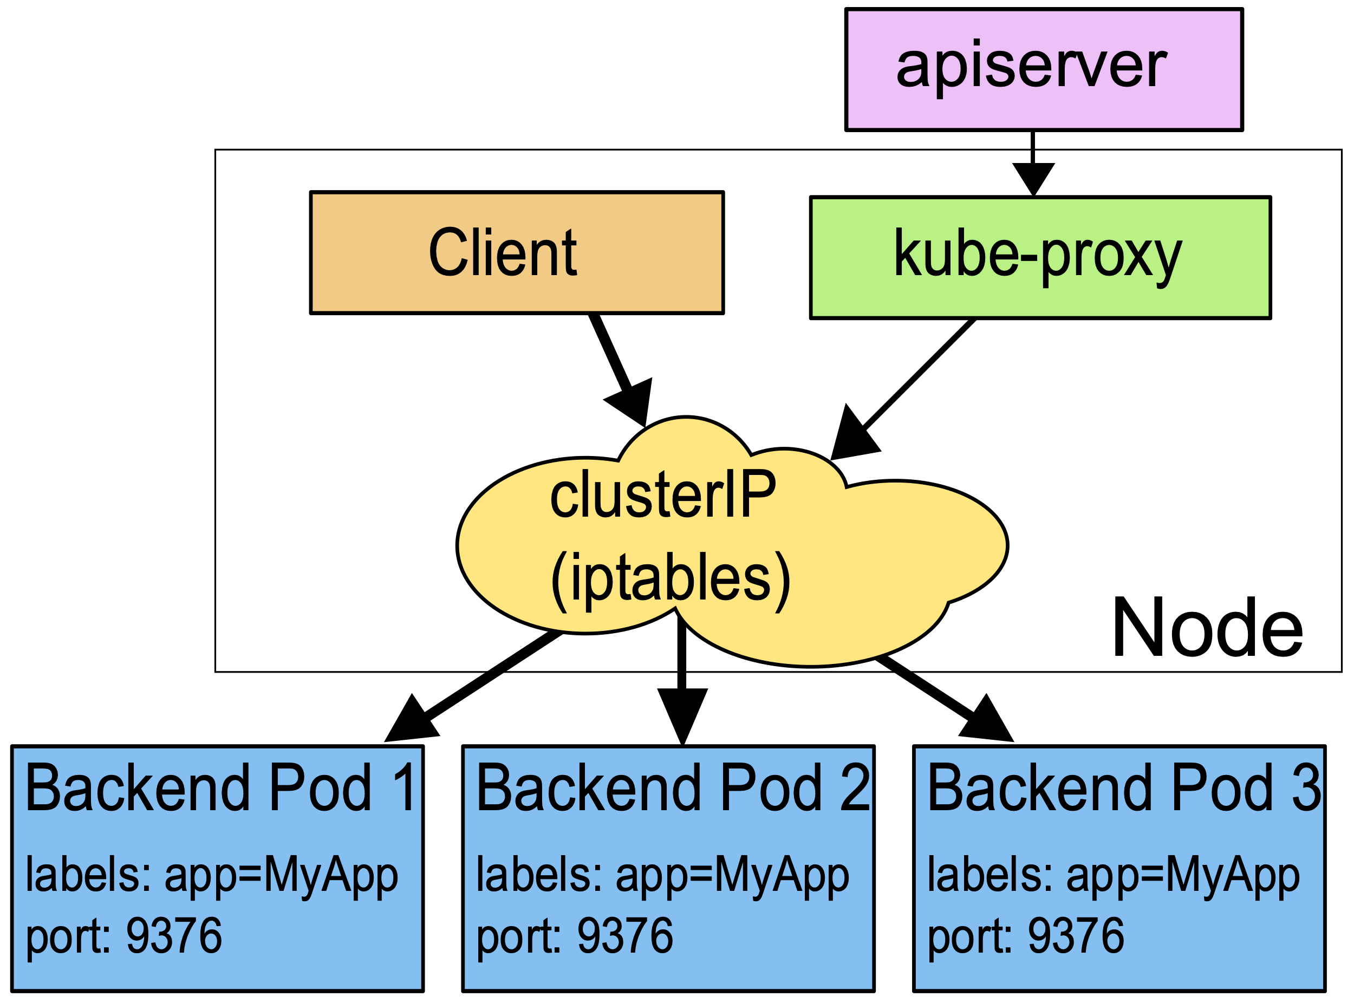
kube-apiserver notifies kube-proxy on every Node on new Service and Endpoints Objects:

Slide 19
kubectl
10.30.0.2:8080
10.40.0.2:80
app=lc-app
app=lc-web
lc-web
10.42.0.1:80
app=lc-web
lc-app
lc-db
Master
Services
Services
Node#3
Docker
kublet
Node#1
kublet
Services
Docker
10.32.0.3:27017
10.43.0.2:80
app=lc-db
app=lc-web
Node#2
Kubernetes Cluster
kublet
Docker

Slide 20
:30XXX
10.105.128.60 :80
Service:
lc-web
10.40.0.2:80
lc-web-pod
10.43.0.3:8080
10.97.14.200:8080
lc-app-pod
Service:
lc-app
10.56.0.3:27017
lc-db-pod
10.87.32.20:27017
Service:
lc-db

Slide 21
Agenda
Kubernetes Introduction
Liveness and Rediness Probes
Liveness and Rediness Probes
ConfigMap and Secrets
Volumes

Slide 22
Liveness
The kubelet uses liveness probes to know when to restart a Container.
For example, liveness probes could catch a deadlock, where an application is running, but unable to make progress.
Restarting a Container in such a state can help to make the application more available despite bugs.

Slide 23
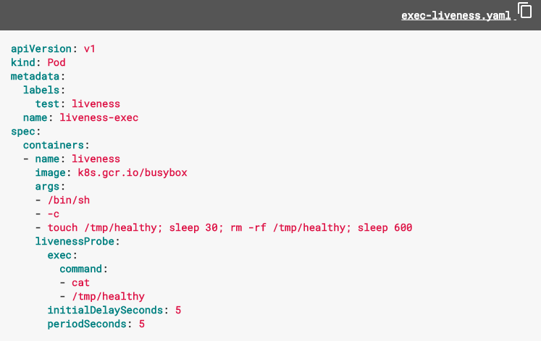

Slide 24
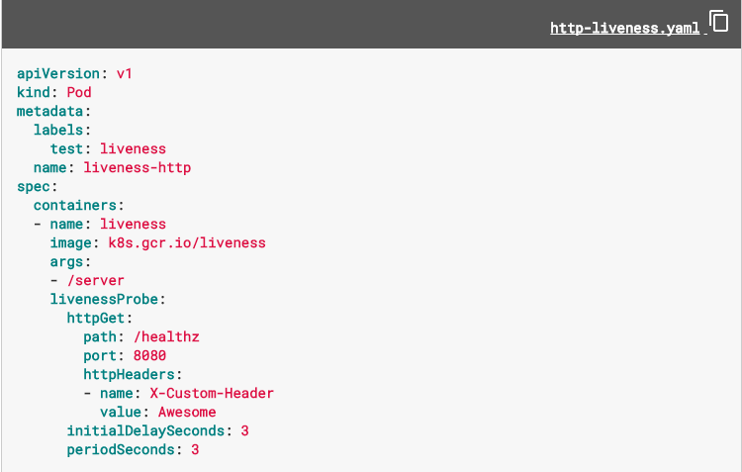

Slide 25
Readiness
An application might need to load large data or configuration files during startup.
A pod with containers reporting that they are not ready does not receive traffic through Kubernetes Services.

Slide 26
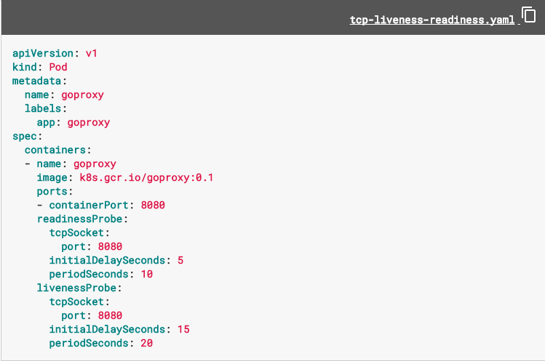

Slide 27
Agenda
Kubernetes Introduction
Liveness and Rediness Probes
ConfigMaps and Secrets
ConfigMap and Secrets
Volumes

Slide 28
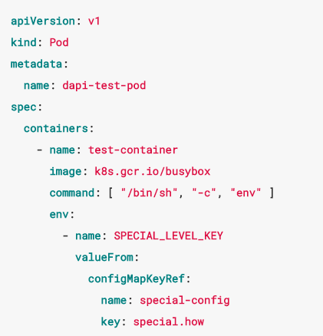
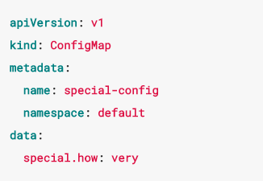
ConfigMap
my-config.yaml
$ kubectl create –f my-config.yaml
$ kubectl create configmap special-config --from-literal=special.how=very

Slide 29
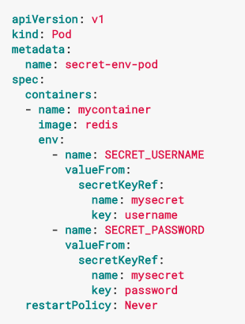
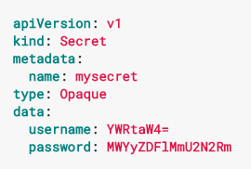
Secret
my-secret.yaml
$ kubectl create –f my-secret.yaml
$ kubectl create secret generic mysecret --from-literal=username=admin --from-literal=password=1f2d1e2e67df

Slide 30
Agenda
Kubernetes Introduction
Liveness and Rediness Probes
ConfigMap and Secrets
Volumes
Volumes

Slide 31
Volumes
We Need Volumes for:
Persistent of Files
Need to share Files Between Containers

Slide 32
Container
File-System

Slide 33
Pod
File-System

Slide 34
Node
File-System
Node
kublet
Docker

Slide 35
Kubernetes Cluster

Slide 36
Types of Volumes
configMap/Secret
projected
emptyDir
hostPath
NFS
CEPH
glusterFS
storageOS

Slide 37
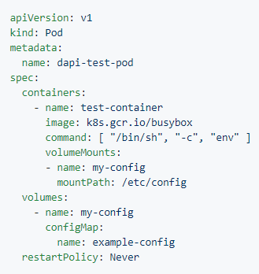
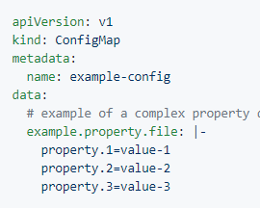
Volume - ConfigMap
my-config.yaml
$ kubectl create –f my-config.yaml
$ kubectl create configmap --from-file=example.property.file

Slide 38
Volume - configMap
Master
navivi/lets-chat-app:v1
configMap
/usr/src/app/config
Node
tmpfs
kublet
Docker

Slide 39
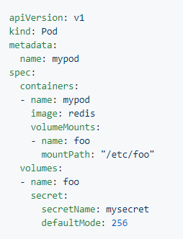
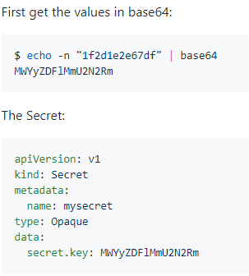
Volume - Secret
$ kubectl create –f my-secret.yaml
$ kubectl create secret generic mysecret --from-file=secret.key

Slide 40
Volume – configMap
And Secret into
2 different Mount Paths
Master
navivi/lets-chat-app:v1
configMap
/usr/src/app/config
Secret
/usr/src/app/docker
Node
tmpfs
kublet
Docker

Slide 41
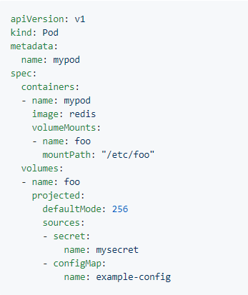
Volume -
Projected

Slide 42
Volume – configMap
And Secret into
The same Mount Path
Master
navivi/lets-chat-app:v1
configMap
/usr/src/app/config
Secret
Node
tmpfs
kublet
Docker

Slide 43
Volume -
emptyDir

Slide 44
Volume – emptyDir
Lets-chat-web Pod – with 2 Containers
navivi/lets-chat-web:v1
blacklabelops/logrotate
/var/log/nginx/letschat
/var/logs/lets-chat
emptyDir

Slide 45
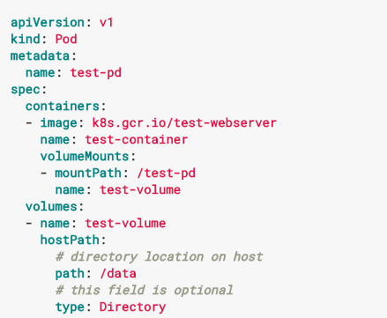
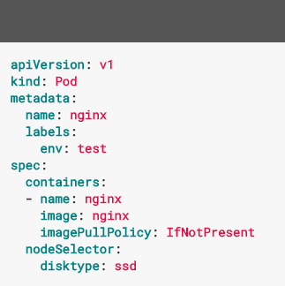
Volume - hostPath

Slide 46
Volume - hostPath
To Node
mongo
File-System
Node
kublet
Docker

